Slide 1

Team Prophet
Comparing Time Series Forecasts for US Energy Consumption

Slide 2

Our Question Worth Analyzing
How much energy will the US consume over the next twelve months?

Slide 3

Data Sources
Monthly energy consumption data from US Energy Information Administration
Jan 1981- Oct 2017
Usage and price data
US Petroleum Products (Million Barrels)
Electrical Generation (Billion Kilowatthours)
U.S. Natural Usage (Billion Cubic Feet)
National average temperature
NOAA
Observation dates

Slide 4

American Energy usage (2017)
Produced 87.5 quadrillion BTU
Consumed 97.7 quadrillion BTU
1 barrel of petroleum =42 gallons = 5,800,000 BTU
1 Kilowatt-hours = 3412.14 BTU
Average American Consumes 300,000,000 BTU = 52 barrels = 87921 KWH

Slide 5

Python Libraries Used
Sci-Kit Learn
Prophet
Pandas
Matplotlib
Keras
Numpy
Datetime

Slide 6

How did we find an answer?
Linear regression model
Sci Kit Learn
Non-linear regression model
Prophet
Deep learning model
Keras

Slide 7

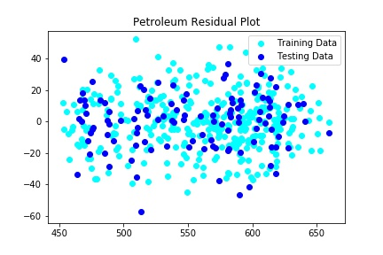
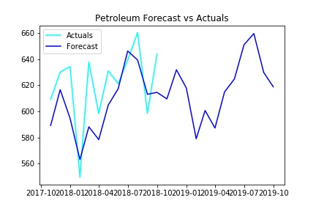
Linear Regression - Petroleum

Slide 8


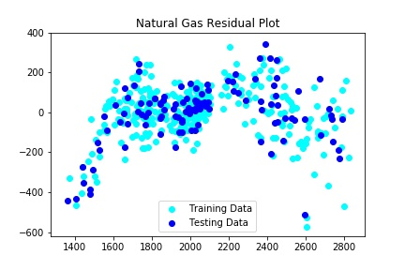
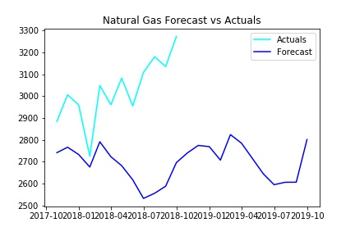
Linear Regression – Natural Gas

Slide 9

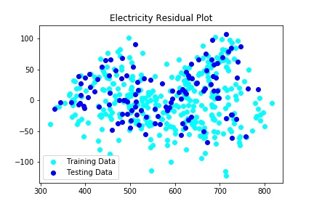
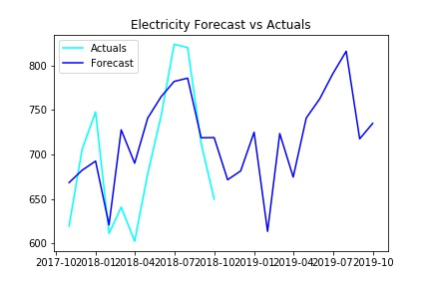
Linear Regression - Electricity

Slide 10


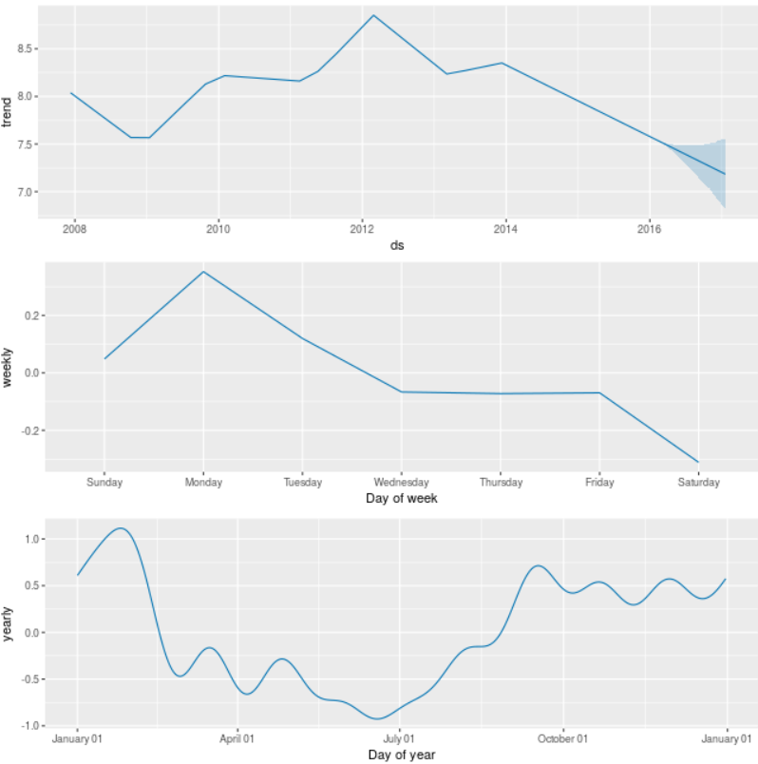
Non-Linear Regression
Prophet forecasting library
Developed by Facebook’s core data science team
Available for python and R
From the developers…
Prophet is a procedure for forecasting time series data based on an additive model where non-linear trends are fit with yearly, weekly, and daily seasonality, plus holiday effects. It works best with time series that have strong seasonal effects and several seasons of historical data. Prophet is robust to missing data and shifts in the trend, and typically handles outliers well.

Slide 11
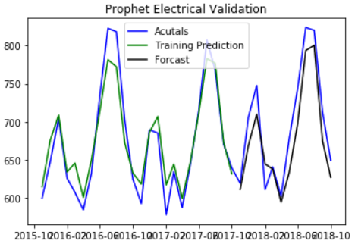
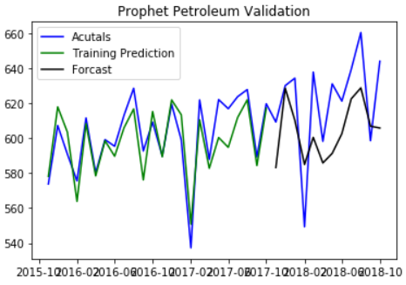
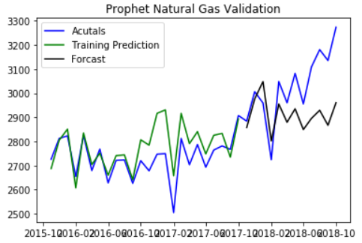
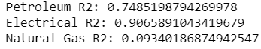
Non-Linear Regression

Slide 12
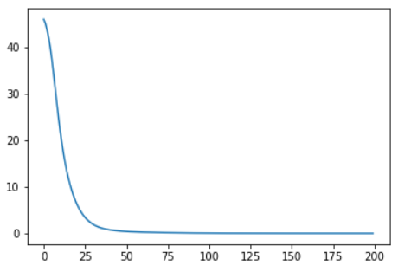
Deep Neural Network
Structure
9 inputs
Temperature, month year, usage, prices
2 hidden layers
27 nodes each
3 outputs
Predicted usage by source
200 epochs
R2 Petroleum – 0.321
R2 Electricity – 0.433
R2 Natural Gas – 0.703

